Slide 1
FLIPKART REVIEWS SENTIMENT ANALYSIS
AI&DS PROJECT

Slide 2
TEAM MEMBERS
2110030022-N VIVEK RAJA
2110030043-A LIKHITHA
2110030089-K PALLAVI SRI
2110030098-S SAI NIKHITHA
2110030100-E SRIVARDHAN

Slide 3
PROBLEM STATEMENT
Flipkart is one of the most popular Indian companies. It is an e-commerce platform that competes with popular e-commerce platforms like Amazon. One of the most popular use cases of data science and artificial intelligence is the task of sentiment analysis of product reviews sold on e-commerce platforms.
The sentiment analysis of the product reviews is a way that can open ways to understand the performance of the products, which is beneficial for both future customers and the e-commerce platform.

Slide 4

LITERATURE SURVEY
This project is based on the analysis of the reviews and ratings user gives on Flipkart to make others aware of their experience and moreover about the quality of the product and brand. So, by analyzing that data we can tell the users a lot about the products and also the ways to enhance the quality of the product.

Slide 5

DATASET REQUIRED
The dataset consists of reviews of the products which customers purchased from Flipkart. The reviews given are the experience about the product customer bought through Flipkart and given a rating to that product.
The dataset for Flipkart contains 3 columns:
ProductName: the name of the product with little details about it.
Review: review what the customer gives about that product.
Rating: ranges from 1 to 5 stars given by the customer.

Slide 6

HARDWARE REQUIREMENTS
Windows 7 or 10
Mac OS X 10.11 or higher, 64-bit
Linux: RHEL 6/7, 64-bit (almost all libraries also work in Ubuntu)
x86 64-bit CPU (Intel / AMD architecture). ARM CPUs are not supported.
4 GB RAM
5 GB free disk space

Slide 7

SOFTWARE REQUIREMENTS
Python
Pandas
Seaborn
Sklearn feature extraction
Matplotlib
WordCloud

Slide 8
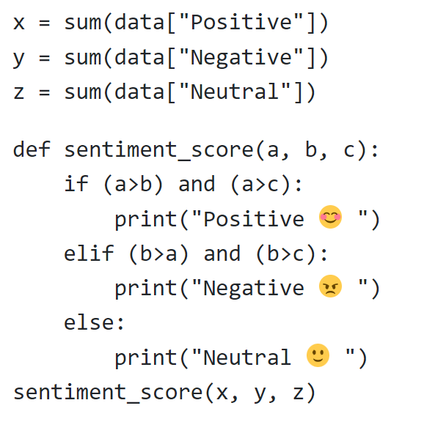
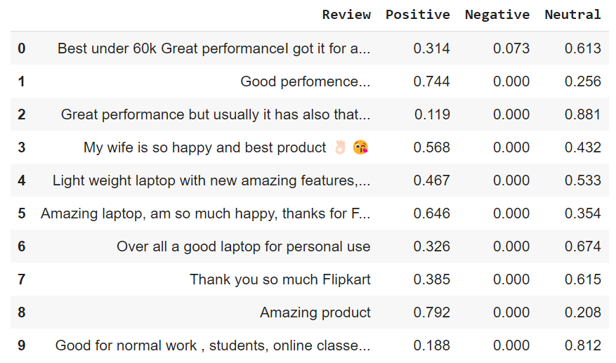
Reviews for the products & Sentiment Analysis
The sentiment_score(x, y, z) returns the sentiment score of the product by using the positive , negative and neutral parameters.

Slide 9
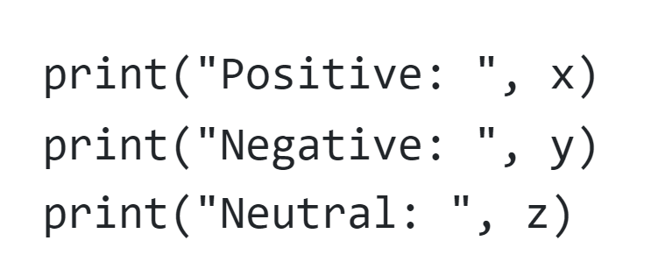
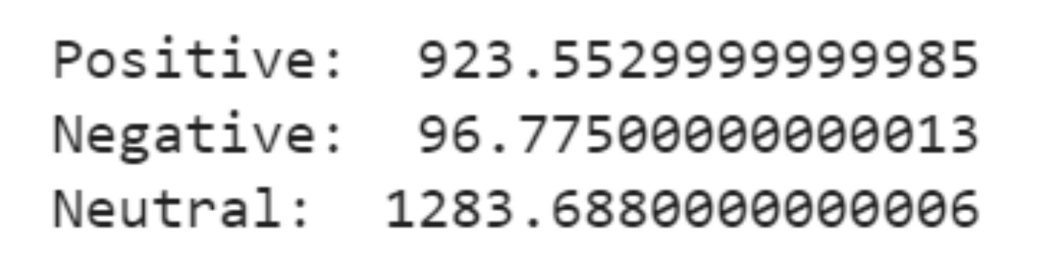
SENTIMENT SCORES

Slide 10
CONCLUSION
So, by the above output, there are 923.55 Positive reviews, 96.77 Negative reviews, and 1283.68 Neutral reviews. With the final output of the entire implementation, the key takeaways can be stated as follows:
Most of the reviews are in favor of Neutral.
The Negative review score has a small proportion, and Positive reviews are midway.
So with the help of the above sentiment analysis implementation, we can conclude that most people are satisfied with the products and services they received from Flipkart.
This states that sentiment analysis is a good process to gather insights into each product, which ultimately benefit present and future customers and e-commerce companies.
Sentiment analysis is important because, based on bad reviews, the e-commerce company makes those products better or replaces those products with better and newer ones, which ultimately improves the overall customer service too.

Slide 11
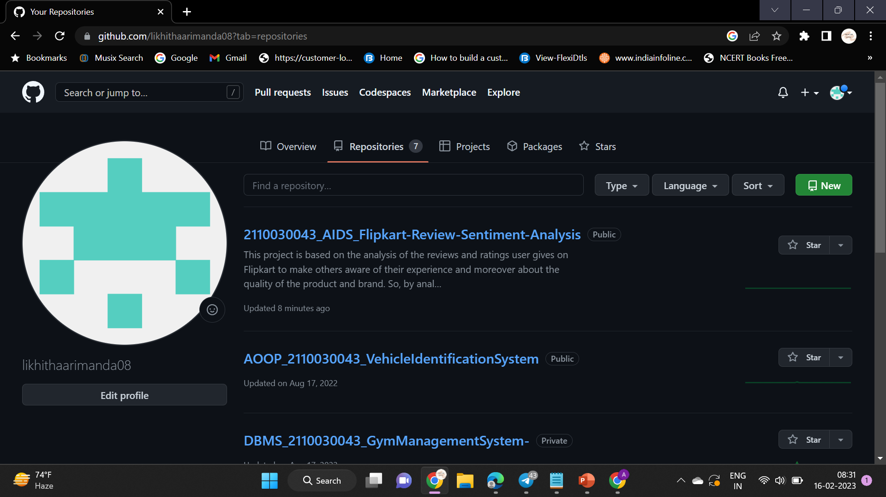
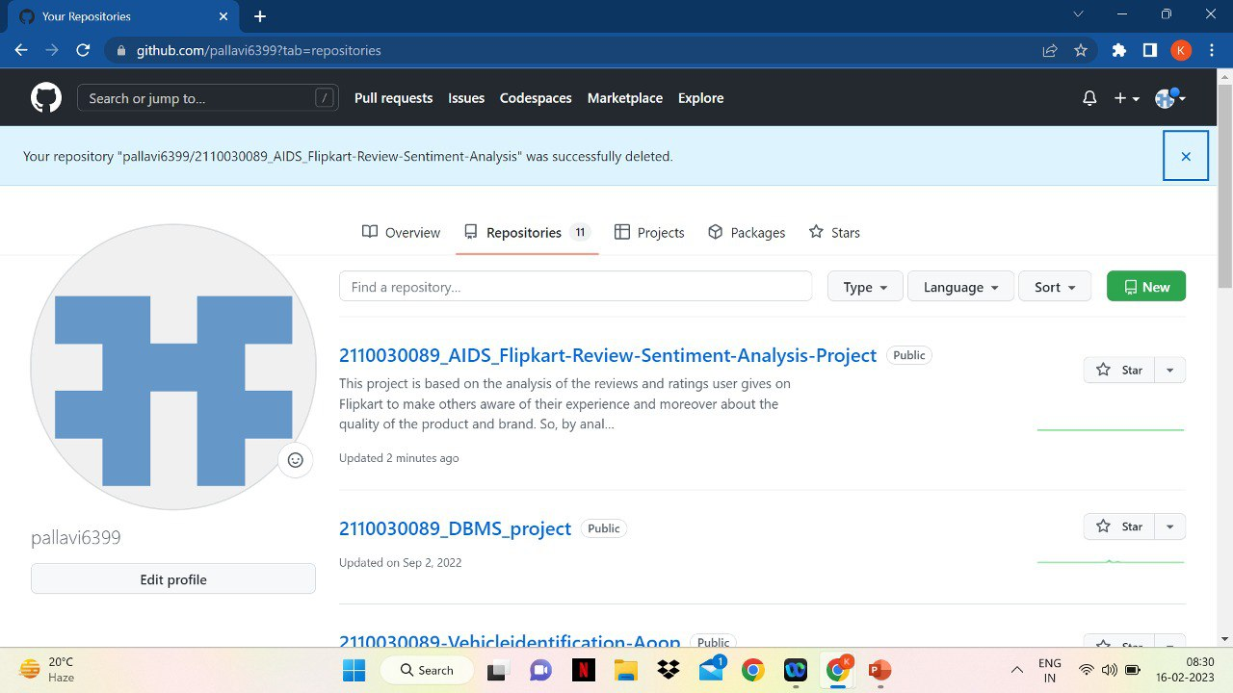
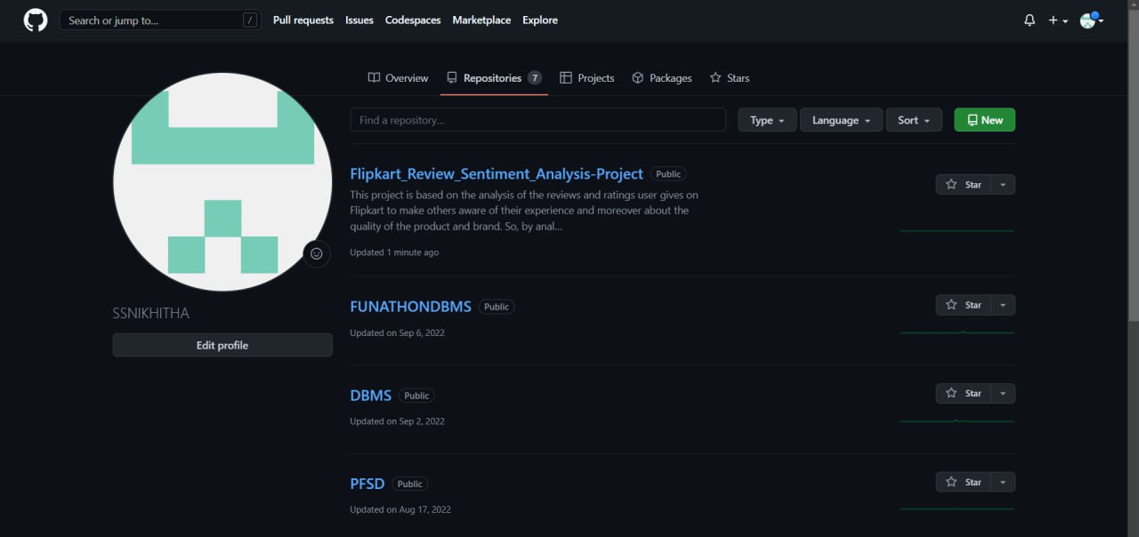
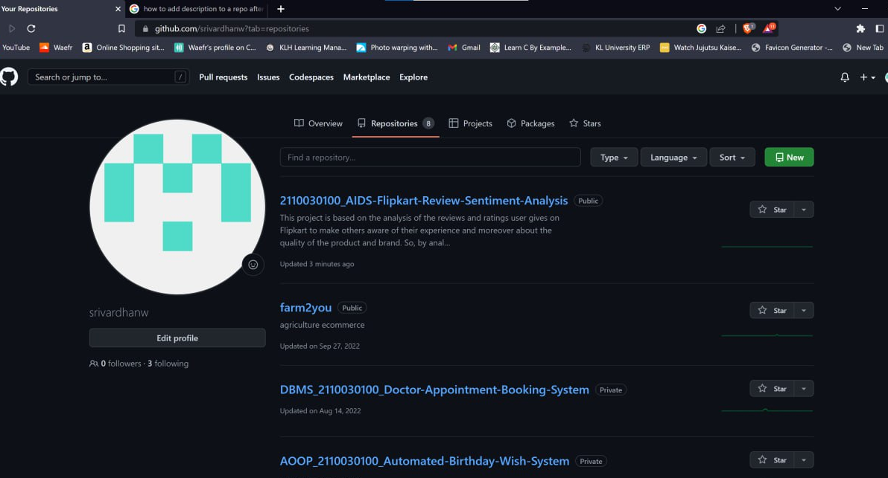
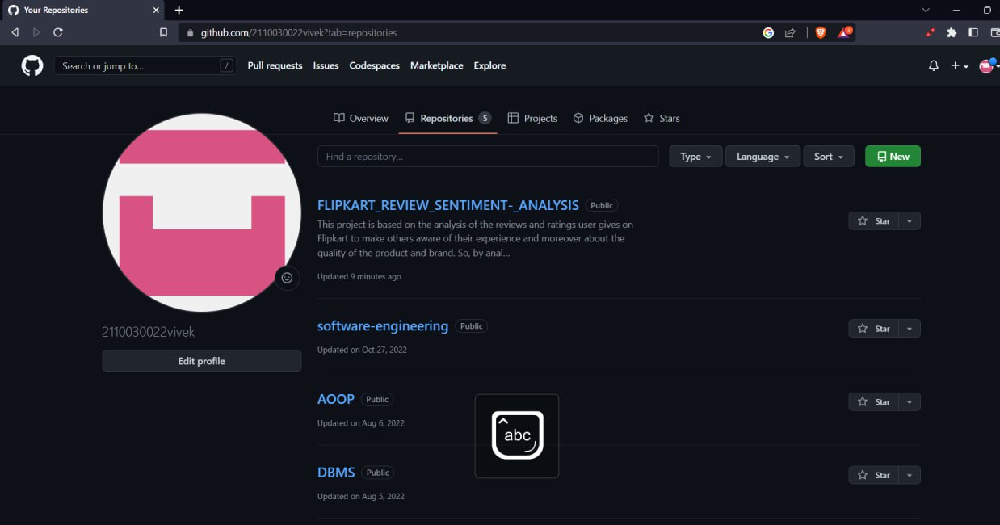
GITHUB SETUP

Slide 12
THANK YOU

